Slide 1

Amazon Sales Report
SAFIKA PARWEEN

Slide 2
Index No. | Title
1 | Introduction
2 | Objective
3 | Data Sharing Agreement
4 | Data Description
5 | Insights
6 | KPIs

Slide 3
INTRODUCTION
Amazon Sales data refers to sales, high performing sellers and several other data points. There are millions of Amazon sellers around the world. Amazon sales data Analysis focuses on the process of analyzing consumer behavior, sales, and several other attributes in order to make improved, data-driven decisions. It is key to successfully sustaining their businesses and earning profits and for this purpose, they analyze different metrics like Total Sales, Sales Quantity, Total Profit, Sales, Last Year Sales and other metrics. By analyzing these different metrics, we will be able to increase and improve our performance.
It can also help us to better understand the market trends and customers’ buying behaviors
and help us to know what the customers really want.

Slide 4
OBJECTIVE
The objective of the project is to Analyse Amazon Sales data to get a substantial data which will help in bringing changes in a business in the future. It will help to reveals flaws in the business model or in the way that one is going about conducting business. Sellers will be able to clearly see where they’re losing money, what the problem is, and reduce their losses accordingly. It facilitates coming up with strategic solutions to problems. This project aims to provide visual understanding of the data.
Using Microsoft Power Bi

Slide 5
DATA SHARING AGGREMENT
File Name: Amazon Sales Data.csv
Dataset Size : 12.4KB
Number of Rows: 100
Number of columns: 14

Slide 6
DATA DESCRIPTION
ORDER ID
The ORDER ID is the ID given to the order.
ORDER DATE
The order date is the date when the product is ordered.
SALES CHANNEL
Mode of shopping Online or Offline.
ORDER PRIORITY
Priority of Sales Range between low to high
SHIP DATE
Ship date when the product is dispatched.
UNIT SOLD
Number of unit sold per product.
UNIT PRICE
Selling Price of the product
REGION
The region in which the customer stays.
COUNTRY
The Country in which the customer reside.
ITEM TYPE
Item type is the varieties of item sales in the Amazon.
UNIT COST
Cost of the Product.
TOTAL REVENUE
Total Sales of the Company.
TOTAL COST
Total Cost of the Company.
TOTAL PROFIT
Total Profit Earned by the Company.

Slide 7
INSIGHTS
KPIS
Month Wise Analysis
Year wise Analysis
Year-Month wise Analysis

Slide 8
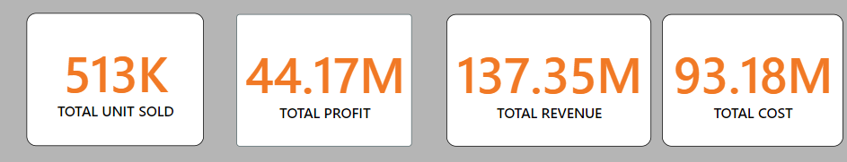
KPI

Slide 9
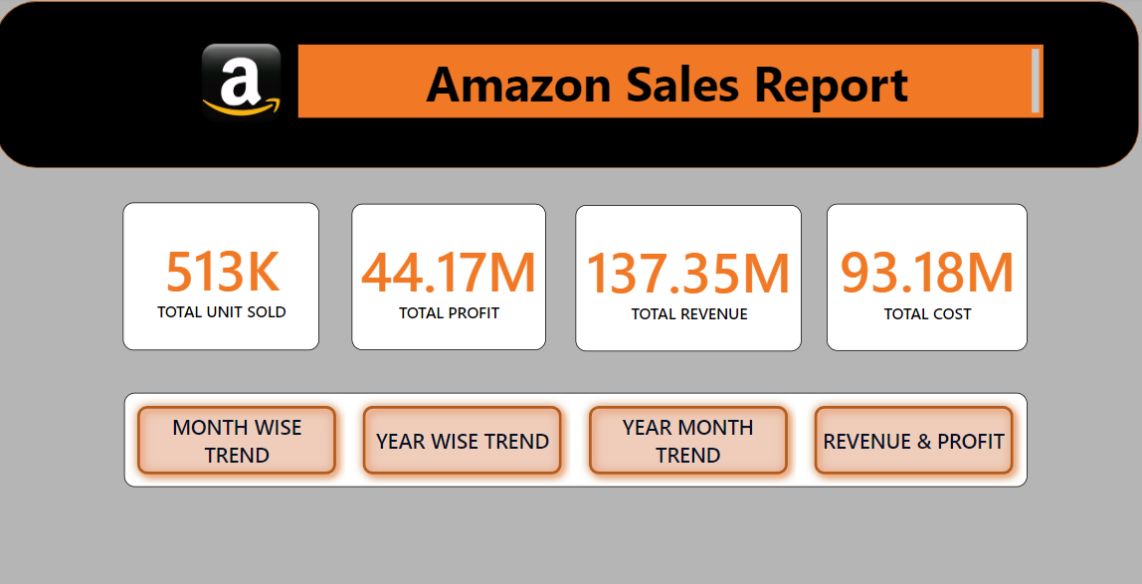
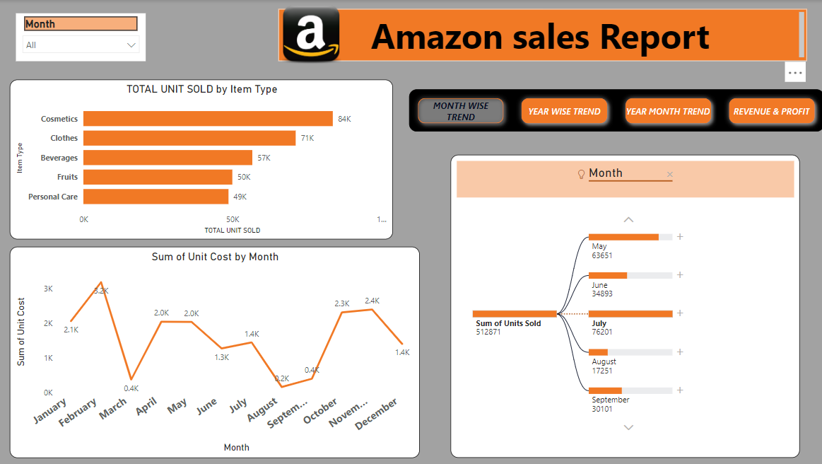
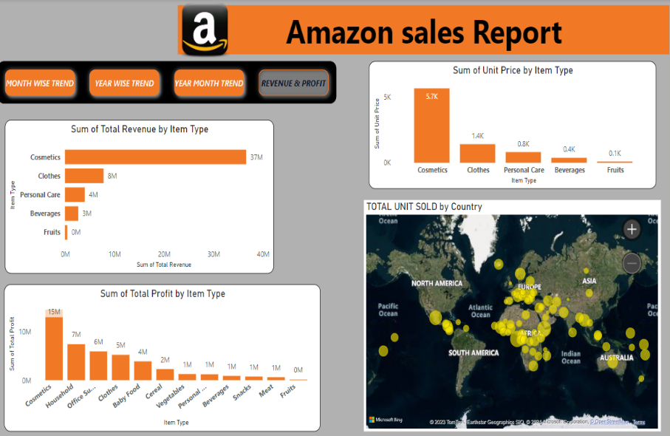
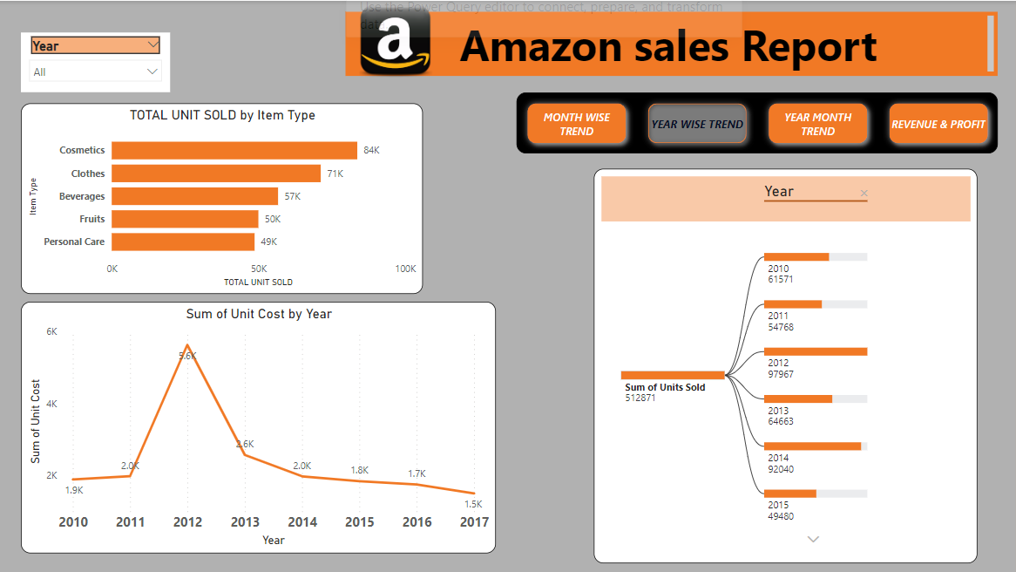
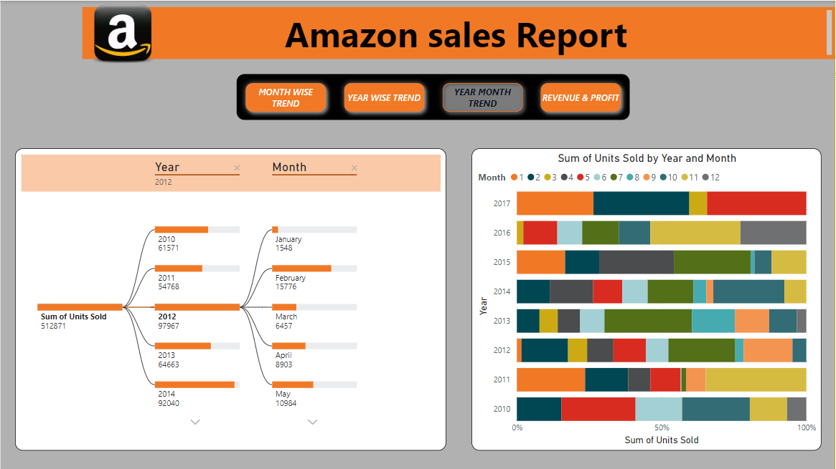
My Design

Slide 10
THANK YOU

